Slide 1

Victoria Crash Data
Dashboard
2019–2023 | Capstone 2 Project Presentation
https://github.com/reyhantodo/Capstone2_Purwadhika
A road-safety analytics project using Python and Power BI to identify crash timing patterns, severity relationships, accident causes, and location hotspots across Victoria.
Reyhan Todo
Purwadhika Digital Technology School
Notes:
Introduce the capstone project and the purpose of the dashboard: converting raw crash data into actionable road-safety insights.

Slide 2
Background & Problem Context
02
Road trauma is a measurable public-safety issue, and Australia/Victoria both have formal targets to reduce deaths and serious injuries.
National target
Victorian target
Open data value
National Road Safety Strategy 2021–2030 targets at least a 50% reduction in fatalities and 30% reduction in serious injuries by 2030.
Victorian Road Safety Strategy 2021–2030 aims to halve road deaths and progressively reduce serious injuries by 2030.
Transport Victoria crash data is consolidated from Victoria Police reports and hospital injury information, then validated and enriched with time, location, conditions and crash type.
Sources: National Road Safety Strategy 2021–2030; Victorian Road Safety Strategy 2021–2030; Transport Victoria Open Data.
Notes:
Use this slide to justify the project. The goal is not only visualization but road safety decision support.

Slide 3
Project Objective & Analytical Questions
03
Objective
Build a cleaned, interactive crash analytics dashboard that explains when, where, how, and how severely crashes occur in Victoria from 2019–2023.
When do crashes happen?
Hour, time period, day of week, monthly trend, yearly trend
What types of crashes dominate?
DCA description, accident type distribution and speed-zone relationship
Where are the hotspots?
Node ID, road name, LGA, latitude and longitude mapping
Which conditions matter?
Speed zone, light condition, road geometry, RMA
How serious are outcomes?
Fatal, serious, other injury and severe accident rate
Notes:
Show the analytical structure that guides the project.

Slide 4
Dataset Scope & Final Analytical Sample
04
60,215
25
2019–2023
4
Final accident records
Columns after preparation
Analysis period
Power BI dashboard pages
Data sources used
Scope decision
Transport Victoria open crash data: accident identifiers, date/time, severity, DCA category, speed zone, light condition, road geometry and RMA.
Detailed location dataset: ROAD_NAME, LGA_NAME, LATITUDE and LONGITUDE.
Derived fields from the notebook: YEAR, MONTH, MONTH_NAME, HOUR, TIME_PERIOD and DAY_TYPE.
The analysis was simplified to 2019–2023 to keep the project manageable while still covering a multi-year period. The final file was imported into Power BI after validation and location enrichment.
Sources: Transport Victoria Open Data
Notes:
Clarify that the presentation uses the final cleaned/merged dataset.

Slide 5
Data Understanding: Final Columns Used
05
The final dataset combines official crash attributes with derived dashboard fields.
Identifier & location
Crash classification
ACCIDENT_NO: unique crash record
NODE_ID: crash location identifier
ROAD_NAME: crash road name
LGA_NAME: local government area
LATITUDE / LONGITUDE: map coordinates
ACCIDENT_TYPE / ACCIDENT_TYPE_DESC
DCA_CODE / DCA_DESC
SEVERITY
Time fields
Road environment
ACCIDENT_DATE / ACCIDENT_TIME
DAY_OF_WEEK / DAY_WEEK_DESC
YEAR / MONTH / MONTH_NAME
HOUR
TIME_PERIOD
DAY_TYPE
LIGHT_CONDITION
ROAD_GEOMETRY_DESC
SPEED_ZONE
RMA
Definitions summarized from the official Transport Victoria data dictionary and project-derived fields.
Notes:
Use this slide to show that all final columns were understood before analysis.

Slide 6
Data Dictionary: Key Codes & Definitions
06
Key code fields were interpreted before analysis to avoid treating category labels as continuous values.
Severity
Light condition
Road geometry
1 = Fatal accident
2 = Serious injury accident
3 = Other injury accident
4 = Non-injury accident
1 = Day
2 = Dusk/dawn
3 = Dark, street lights on
4 = Dark, street lights off
5 = Dark, no street lights
6 = Dark lighting unknown
9 = Unknown
Cross / T / Y / multiple intersections
Not at intersection
Dead end / road closure
Private property / unknown
DCA code and description
Project-specific sorting
Definition for Classifying Accidents: detailed crash movement/type such as rear-end, right-through, cross-traffic, off-carriageway and pedestrian-related events.
DAY_OF_WEEK was standardized as Monday = 1 through Sunday = 7 for dashboard sorting
Source: Transport Victoria Open Data Dictionary.
Notes:
Explain why severity and light condition code interpretation is critical.

Slide 7
Data Cleaning & Preparation Workflow
07
1
2
3
4
Reduce scope
Parse dates/time
Validate weekdays
Extra fields
Filtered to 2019–2023
Created YEAR, MONTH, HOUR
Fixed DAY_OF_WEEK sorting
Created TIME_PERIOD and DAY_TYPE
Final cleaning result
Final dataset: 60,215 rows × 25 columns
No missing values, No duplicate rows and no duplicate ACCIDENT_NO
No invalid parsed dates
DAY_OF_WEEK and DAY_WEEK_DESC fully aligned
Notes:
This slide summarizes the actual notebook cleaning process in a sequence.

Slide 8
Data Quality & Distribution Checks
08
Data quality results
Distribution observations
Missing values = 0
Duplicate rows = 0
Duplicate ACCIDENT_NO = 0
Invalid dates = 0
Day crosstab total = dataframe total (60,215)
Unknown road geometry = 95 records (0.16%)
Severity: 1,021 fatal; 22,073 serious; 37,117 other injury
Speed zone 60 km/h recorded the highest count: 21,511
Road geometry dominated by “Not at intersection” (31,749)
RMA dominated by Arterial Other and Local Road, both above 22K
Shapiro-Wilk checks indicated the numeric-coded variables were not normally distributed
Method implication
Because the dataset is dominated by categorical and discrete coded variables, the analysis prioritizes counts, crosstabs, heatmaps, severe accident rate and hotspot mapping instead of relying on normal-distribution assumptions.
Notes:
Discuss the clean data status and why categorical methods were more meaningful.

Slide 9
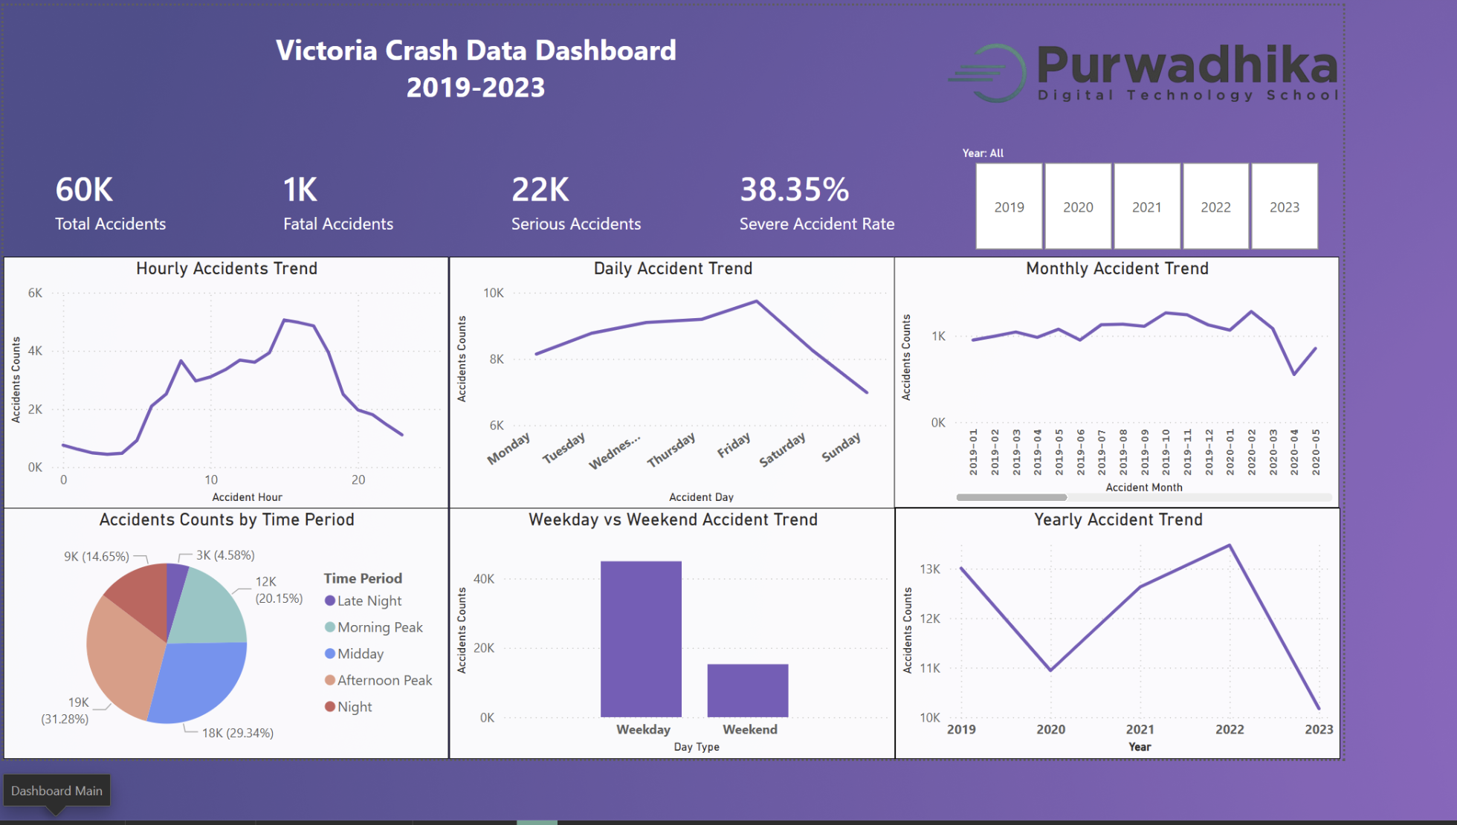
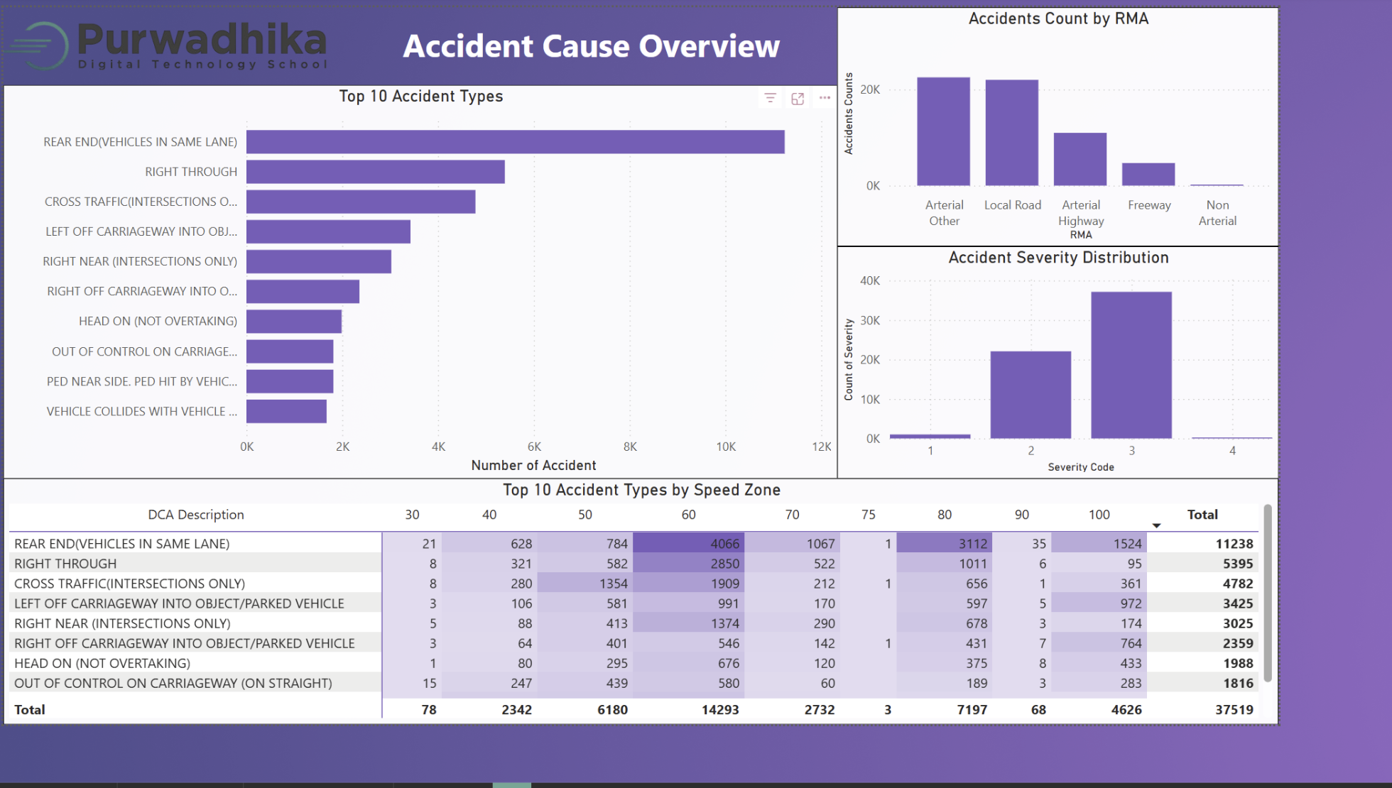
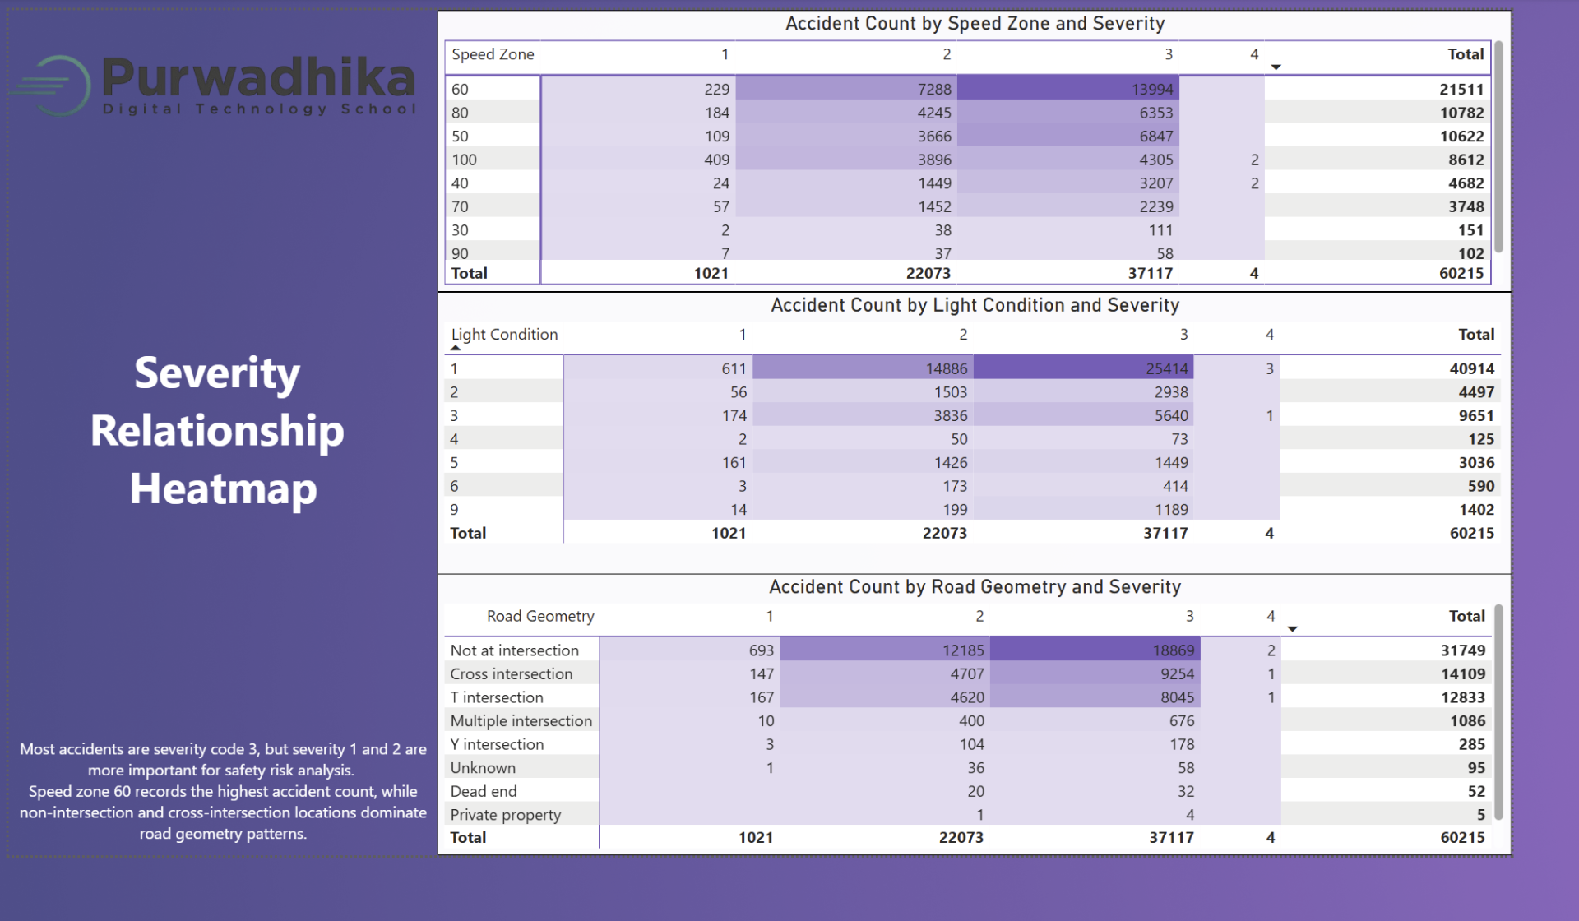
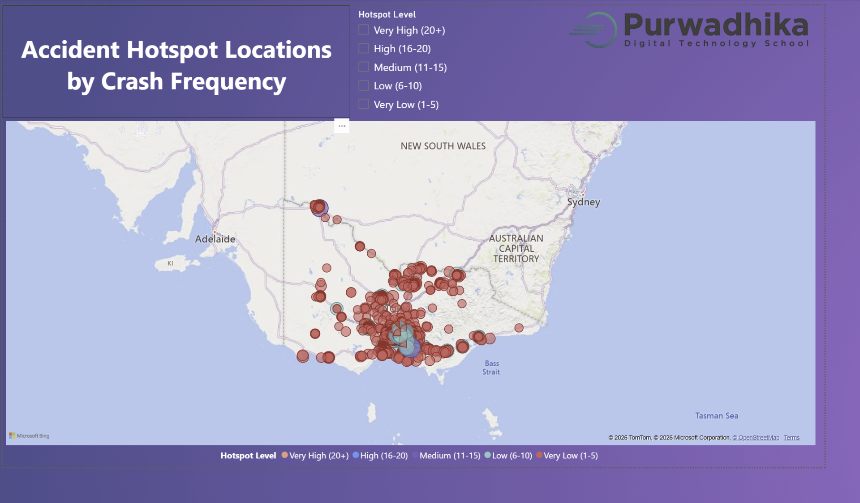
Power BI Dashboard Structure
09
Four dashboard pages were built to separate the story by purpose: overview, cause analysis, severity relationships, and location hotspots.
Notes:
This slide gives the audience an overview of the deliverable.

Slide 10
Crash Trend Patterns
10
Key results
Afternoon peak is the largest time-period group: 18.835 accidents (31.28%).
Midday is also high: about 17666 accidents (29.34%).
Hourly pattern peaks around afternoon commuting hours.
Friday is the highest day; Sunday is the lowest.
Weekday totals exceed weekend totals, but exposure should be considered because weekdays cover more days.
Interpretation
Crash risk is time-dependent. Peak-hour and Friday travel patterns are good targets for monitoring, enforcement and public messaging.
Notes:
Temporal insights are usually easy for stakeholders to understand.

Slide 11
Accident Cause & Road Authority Patterns
11
Key results
Most common accident type: rear-end crashes in the same lane (11,238 records; 18.66%).
Other high-frequency patterns include right-through, cross-traffic at intersections, off-carriageway into objects/parked vehicles and right-near intersection crashes.
RMA distribution is concentrated in Arterial Other and Local Road categories, each above 22K crashes.
The DCA × Speed Zone heatmap shows many top accident types concentrated in 60 km/h zones.
Interpretation
Rear-end and intersection-related patterns point to congestion, following distance, turning conflicts and intersection design as major crash themes.
Notes:
Cause overview combines DCA, RMA and speed-zone relationships.

Slide 12
Severity Relationship Heatmaps
12
Severity summary
1,021
22,073
Fatal accidents
Serious injury accidents
38.35%
Severe accident rate
Severity code 3 is the largest outcome group, but severity 1 and 2 are the key safety-risk priorities.
Speed zone 60 km/h has the highest accident count.
Most crashes occur in daylight conditions, likely due to higher daytime traffic exposure.
Not-at-intersection and intersection-related road geometries dominate the severity matrices.
Notes:
Explain why the heatmaps show relationships more clearly than simple totals.

Slide 13
Insight 4 — Accident Hotspot Mapping
13
How the map works
Crash locations are mapped using latitude and longitude from the merged location dataset.
NODE_ID identifies crash location; multiple crashes can occur at the same node.
Bubble size represents crash count; hotspot levels group nodes by crash frequency.
Map supports filtering by hotspot level and time period.
Result
Hotspots concentrate around Victoria’s urban and road-network corridors, especially metropolitan Melbourne and key regional corridors.
Use case
Combine hotspot frequency with severity rate to prioritize road safety audits, signage, lighting, lane design and intersection treatments.
Notes:
The map is the most practical output for location-based recommendations.

Slide 14
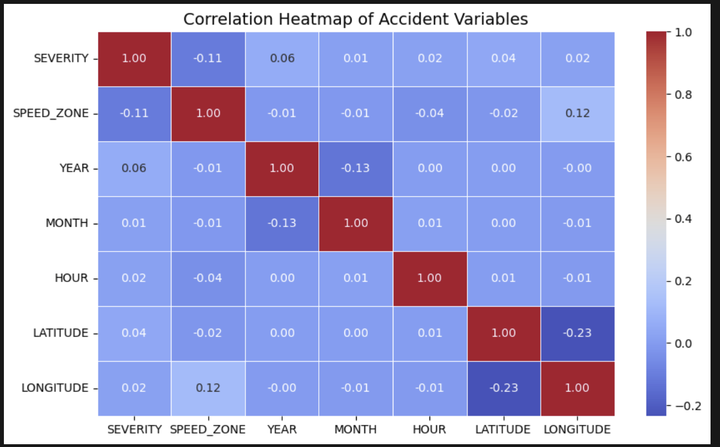
Statistical Relationship Check
14
Correlation result
No selected numeric pair showed a strong correlation.
Largest off-diagonal values were still weak, such as latitude vs longitude around −0.23.
Speed zone vs severity was very weak, around −0.11.
This is expected because many fields are category codes rather than continuous measurements.
Method decision
For categorical crash data, use “association” rather than “correlation.” Cross-tabulation, heatmaps, severe accident rate and Cramer’s V are more meaningful than Pearson correlation alone.
Notes:
This slide helps explain how to defend the analytical method.

Slide 15
Recommendations
15
Recommendations are based on timing, crash mechanism, road environment and hotspot location patterns.
Target peak-period risk
Use hotspot map for safety audits
Focus enforcement, public messaging and congestion management around afternoon peak and Friday travel patterns.
Prioritize high-frequency nodes, then refine by severe accident rate to avoid relying only on total volume.
Reduce rear-end crashes
Improve environmental treatments
Promote safe following distance and improve traffic-flow management at congested corridors and signalized approaches.
Review lighting, signage, lane marking and visibility around dark or intersection-related severe crash patterns.
Prioritize high-count environments
Investigate 60 km/h corridors, non-intersection segments, cross intersections and T intersections.
Notes:
Link each recommendation to prior dashboard findings.

Slide 16
Summary & Conclusion
16
Final takeaway
The project transforms raw crash records into a practical road-safety dashboard that identifies crash timing, common causes, severity patterns and hotspot locations.
What was achieved
What it enables
Cleaned and validated a 2019–2023 crash dataset.
Merged location data and created dashboard-ready fields.
Built a 4-page Power BI report for time, cause, severity and hotspot analysis.
Faster exploration of crash patterns.
Location-based prioritization through hotspot mapping.
More focused recommendations for enforcement, infrastructure, lighting, signage and safety audits.
Notes:
Close with the practical value of the dashboard and future improvement opportunities.

Slide 17
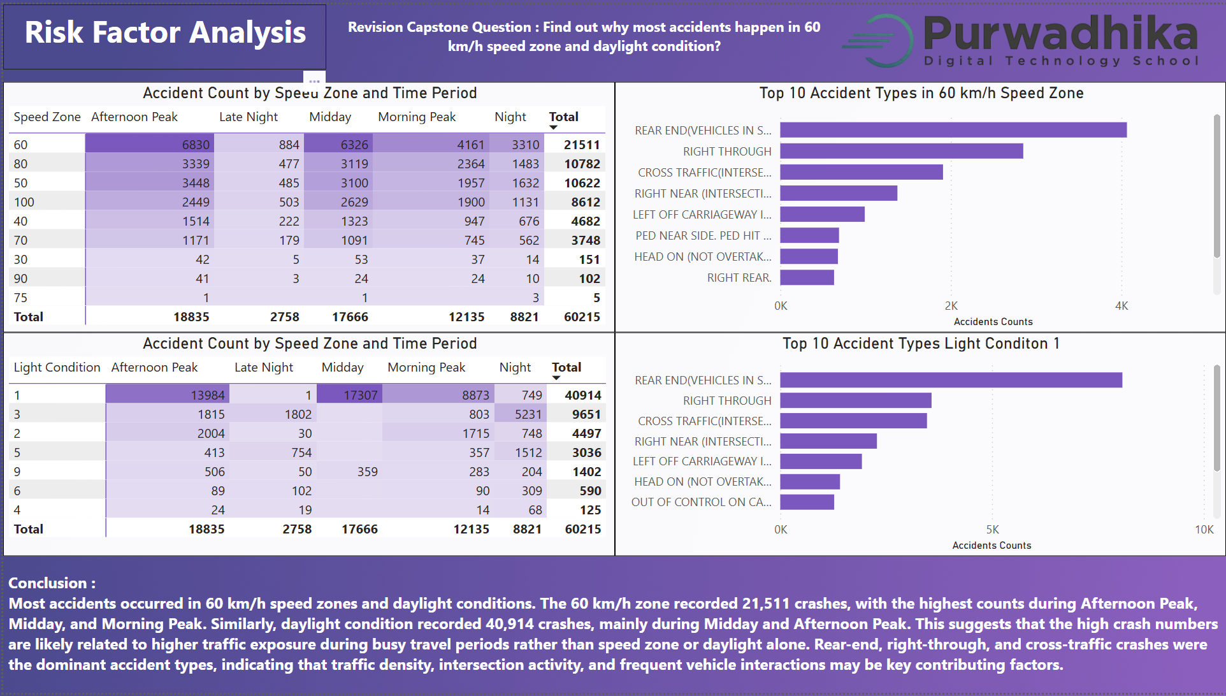
Improvement (Revisi)
17
Why it happens?
The risk factor analysis shows that most crashes occurred in the 60 km/h speed zone and under daylight conditions.
When analysed by time period, most crashes in this speed zone happened during the Afternoon Peak with 6,830 crashes, followed by Midday with 6,326 crashes and Morning Peak with 4,161 crashes. This suggests that the high number of crashes in 60 km/h zones is likely related to high traffic activity during busy travel periods, especially commuting hours and daytime road use.
The most common accident types in the 60 km/h speed zone were rear-end crashes, right-through crashes, and cross-traffic crashes. These accident types are often connected to urban and arterial road conditions, where vehicles frequently stop, turn, merge, and interact at intersections. Therefore, the high accident count in 60 km/h zones may not be caused by speed alone, but also by traffic density, road complexity, and frequent vehicle movement.
Light condition 1, which represents daylight, also recorded the highest number of crashes, with 40,914 accidents. Most daylight crashes occurred during Midday with 17,307 crashes, followed by Afternoon Peak with 13,984 crashes and Morning Peak with 8,873 crashes. This shows that daylight crashes are likely higher because most road activity happens during the day, when more vehicles, pedestrians, and other road users are active. Therefore, daylight should not be seen as a dangerous condition by itself. Instead, the high crash count is more likely caused by higher road exposure and heavier traffic during daylight hours.
Notes:
The map is the most practical output for location-based recommendations.

Slide 18
Sources & References
18
References used for dataset definitions, road-safety context and project evidence.
1. Transport Victoria Open Data — Victoria road crash data
https://opendata.transport.vic.gov.au/dataset/victoria-road-crash-data
2. Transport Victoria Open Data — Victorian Road Crash Data: Data Dictionary
https://opendata.transport.vic.gov.au/dataset/victoria-road-crash-data/resource/5df1f373-0c90-48f5-80e1-7b2a35507134
3. Transport Victoria Open Data — Accident Location / Node resources
https://opendata.transport.vic.gov.au/dataset/victoria-road-crash-data
4. Victorian Road Safety Strategy 2021–2030
https://www.tac.vic.gov.au/road-safety/victorian-road-safety-strategy/victorian-road-safety-strategy-2021-2030
5. National Road Safety Strategy 2021–2030
https://www.roadsafety.gov.au/nrss
Thank you
Notes:
End of presentation.

